Slide 1
Learning Latent Dynamics For Planning from Pixels
Danijar Hafner . Timothy Lillicrap . Ian Fischer . Ruben Villegas . David Ha. Honglak Lee . James Davidson
Presented By
Emmanuel Olateju

Slide 2
Overview
Planning In Unknown Environments- Challenges
Learning accurate models
Accumulating errors in multi-step predictions
Failure to capture multiple possible futures
Overconfident predictions outside training distribution
Limitations of Existing Methods
Prior work assumes access to low-dimensional ground truth state of world and reward functions — not available from pixels
Success limited to simple tasks — cartpoles, 2-link arms, dense rewards only
Latent space models previously couldn't scale to contact dynamics, sparse rewards, or partial observability
PlaNet
Learning of environment dynamics from images
Fast online planning in latent space
Multi-step prediction of rewards
Latent overshooting - variational inference
Planning With Learned Dynamics - Advantages
More data efficient — richer training signal, no Bellman backups needed
Performance scales with compute budget for action search
Learned dynamics are task-independent — potential for transfer
"Can we learn a dynamics model purely from pixel observations that is accurate enough for planning?"

Slide 3
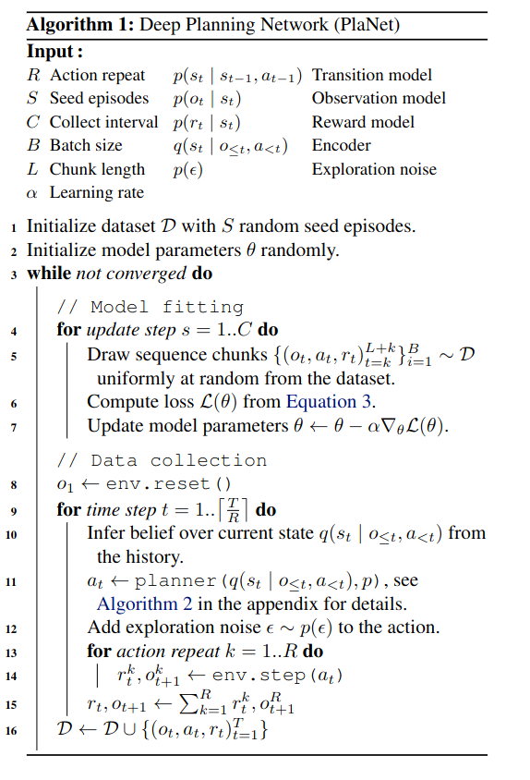



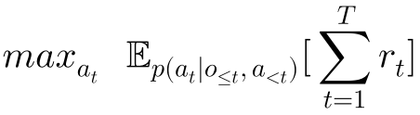

Model-Predictive Control (MPC)
“Repeat after each new observation”
Policy
●
●
◆
●
◆
Planning Objective
◆
MPC Summary
Data Collection
◆
Fixed starting point or state
Predict future behavior using dynamic system model (transition model)
Optimize action sequences (over a planning horizon) to maximize expected cumulative reward
Initial S-seed episodes collected using random actions.
Model training on collected experience
New episode added to dataset every C training steps
Notes:
Gaussian exploration noise added to action.
Action repitition for R times

Slide 4


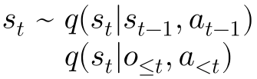
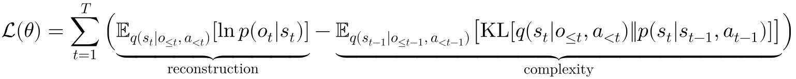
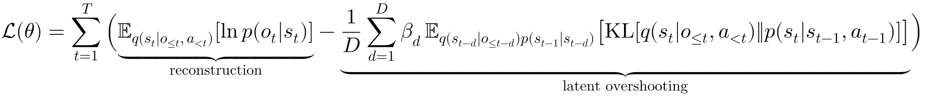
PlaNet
“Repeat after each new observation”
PlaNet Summary
Models
Trained using a VAE-style variational objective (encoder + decoder)
Encoder infers approximate posterior state belief from observation history
Learned latent dynamics model predicts future states without generating images enabling fast planning in latent space
Observation model provides a rich training signal but is excluded from planning
Transition Model (RSSM): Deterministic (RNN) + Stochastic (Gaussian) Path
Encoder (Approximate Posterior): Gaussian, CNN + FFN
Observation Model: Gaussian, deconvolutional-Net (transposed CNN)
Reward Model: Scalar Gaussian, FFN
●
Approximate
Posterior
●
●
●
One Step Prediction
Latent Overshooting
Notes:
Reconstruction term unchanged
Latent overshooting is multi-step prediction including beta weighting factor inspired from beta-VAE
beta can be shosen to make the model focus on long or short term predictions but is set to 1 for simplicity

Slide 5
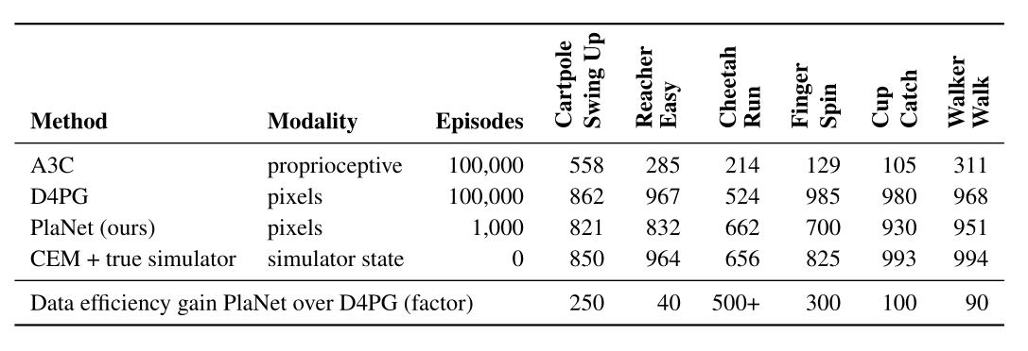
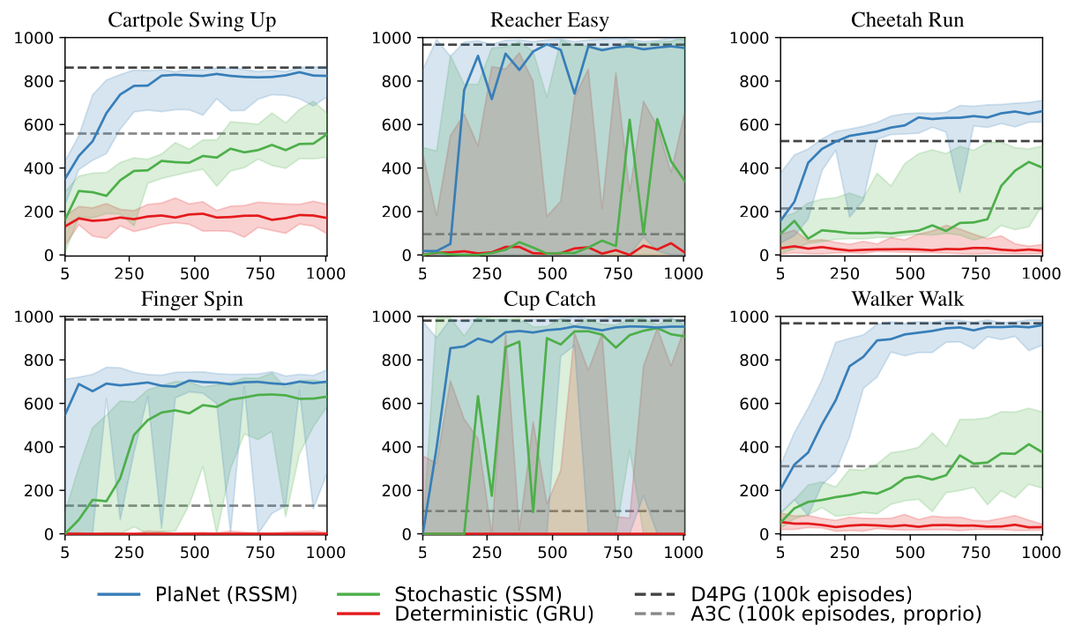
Results
Key Takeaways
PlaNet matches D4PG performance using 100× fewer episodes on average
Outperforms A3C on all tasks within just 100 episodes — A3C needed 100,000
Cheetah Run: PlaNet surpasses D4PG by 26% — the only task where model-based explicitly beats model-free
Both stochastic and deterministic paths are critical — pure GRU and pure SSM both fail to match RSSM
Finger Spin is the weakest result — PlaNet does not match D4PG here, showing contact-heavy tasks remain challenging
PlaNet vs Model-Free Algorithms

Slide 6
Limitations and Future Work
Limitations
Future Work
Finger Spin shows contact-heavy tasks remain difficult for latent planning
Planning horizon is fixed — no temporal abstraction due to cross-emtropy method used.
Latent overshooting slightly reduces RSSM performance — benefit is model-dependent (helps simpler DRNN, hurts RSSM)
Limited visual diversity: cannot learn representations without reconstruction, reconstruction may model irrelevant visual features
Learn temporal abstraction through hierarchical models instead of fixed action repeat
Learn a value function to approximate rewards beyond the planning horizon - DREAMER
Gradient-based planning for better computational efficiency - cross entropy method is a population based search approach
Learn representations without reconstruction to handle higher visual diversity
Multi-task control by sharing the dynamics model across tasks

Slide 7
THANK YOU

